Slide 1

12 FACTOR APP
12 FACTOR APP
DONE BY:
PRAGATHI, PRAKRUTHI, RAMYA, SUBHASHREE

Slide 2
Definition
WHAT IS 12 FACTOR APP
Definition
A methodology or process created specifically for building Software as a Service (SaaS) apps, the 12 Factor Applications can help you avoid headaches typically associated with long term enterprise software projects.
Drafted by developers at Heroku based upon their observations of what made good apps. First presented by Adam Wiggins circa 2011 (then published in 2012)

Slide 3
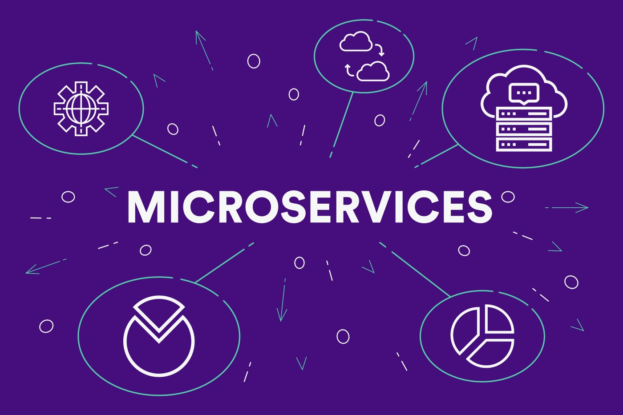
WHAT ARE THEY?
MICROSERVICES
A microservices architecture deals with loosely coupled services which can be developed, deployed, and maintained independently. Each of these services is responsible for discrete task and can communicate with other services through simple APIs to solve a larger complex business problem. Microservices also offer improved fault isolation whereby in the case of an error in one service the whole application doesn’t necessarily stop functioning. When the error is fixed, it can be deployed only for the respective service instead of redeploying an entire application.
Notes:
To change the image behind the Mock up.
Select the layer - > Right Click -> Send to Back -> Delete the image -> Drag & Drop your Own Picture -> Send to Back (again)

Slide 4

WHY?
WHY SHOULD WE USE 12 FACTOR APP
WHY?
It uses declarative formats for setup automation.
It works with a clean contract with the underlying operating system for greater portability between environments
It limits the differences between development and production, by enabling continuous deployment
It allows for scaling up without major changes

Slide 5
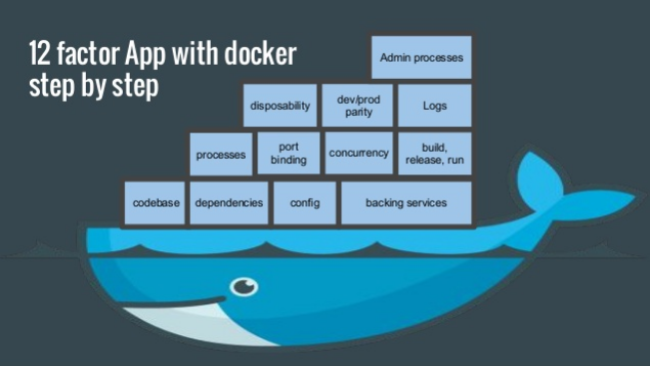

Slide 6
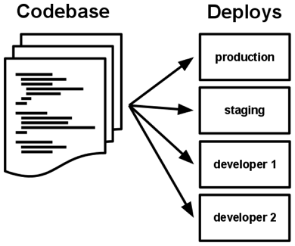
CODEBASE
ONE CODEBASE, MANY DEPLOYS
CODEBASE
A codebase is any single repo (in a centralized revision control system like Subversion), or any set of repos who share a root commit (in a decentralized revision control system like Git). There is only one codebase per app, but there will be many deploys of the app. A deploy is a running instance of the app. This is typically a production site, and one or more staging sites. Every developer has a copy of the app running in their local development environment, each of which also qualifies as a deploy.
Notes:
To change the image behind the Mock up.
Select the layer - > Right Click -> Send to Back -> Delete the image -> Drag & Drop your Own Picture -> Send to Back (again)

Slide 7
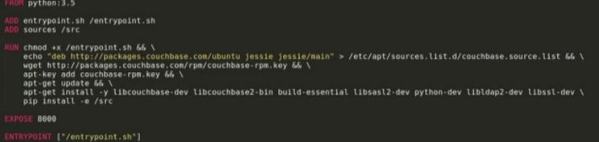
DEPENDENCIES
EXPLICITLY DECLARE AND ISOLATE
2. DEPENDENCIES
Try to avoid copying any dependencies to the project codebase, instead use a package manager. Always remember to use the correct versions of dependencies so that all environments are in sync and reproduce the same behavior.
For example, in Python there are two separate tools for these steps like Pip is used for declaration and Virtualenv for isolation.
Notes:
To change the image behind the Mock up.
Select the layer - > Right Click -> Send to Back -> Delete the image -> Drag & Drop your Own Picture -> Send to Back (again)

Slide 8
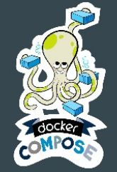
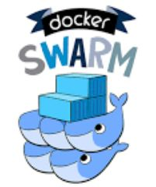
CONFIG
STORE IN THE ENVIRONMENT
3. CONFIG
Config is the specific information required to host a deployment of your codebase. It mainly includes database credentials, path URLs, etc.Store the config in Environment Variable (Env vars). There should be a strict separation between config and code. The code should remain the same irrespective of where the application is being deployed, but configurations can vary.
docker-compose can define env variables via an .env file
“docker-compose up” is the command used to start the compose
Even docker swarm can be used.
Notes:
To change the image behind the Mock up.
Select the layer - > Right Click -> Send to Back -> Delete the image -> Drag & Drop your Own Picture -> Send to Back (again)

Slide 9
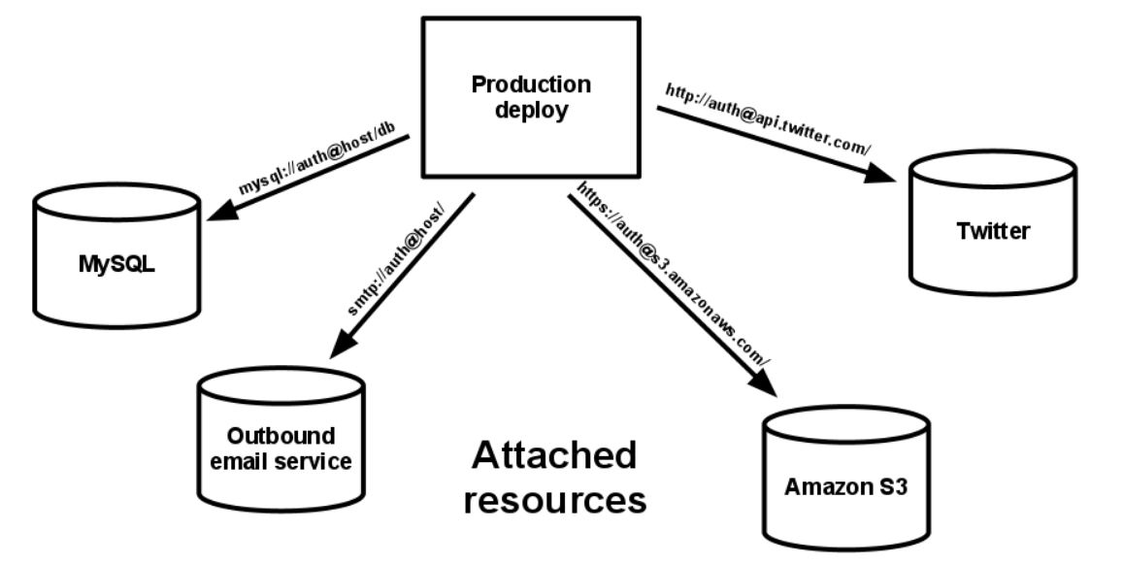
AS ATTACHED RESOURCES
BACKING SERVICES
4. BACKING SERVICES
The idea is that your services should be easily interchangeable. If you are referencing them as simple urls with login credentials there is no reason why they shouldn’t be. A backing service such as an MySQL DB should be able to be swapped out without any changes to the code.This will ensure good portability and helps maintain your system. Some more examples of backing system include: SMTP, Datastore etc
Notes:
To change the image behind the Mock up.
Select the layer - > Right Click -> Send to Back -> Delete the image -> Drag & Drop your Own Picture -> Send to Back (again)

Slide 10
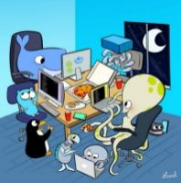
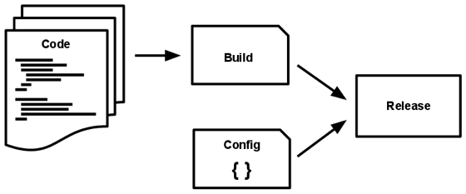
BUILD, RELEASE, RUN
STRICTLY SEPARATE BUILD AND RUN SERVICES
5. BUILD, RELEASE, RUN
The build stage involves the process of converting source code files into an an executable bundle.
The release stage takes the build produced by the build stage and combines it with the deploy’s current config.
The run stage (also known as “runtime”) runs the app in the execution environment.
BUILD:
docker build --pull -t sampleapi:1.0
RELEASE:
docker push sampleapi:1.0
RUN:
docker run sampleapi:1.0
Notes:
To change the image behind the Mock up.
Select the layer - > Right Click -> Send to Back -> Delete the image -> Drag & Drop your Own Picture -> Send to Back (again)

Slide 11
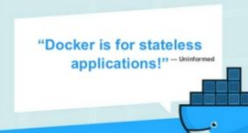
PROCESSES
EXECUTE THE APP AS ONE OR MORE STATELESS PROCESSES
6. PROCESSES
Twelve-factor processes are stateless and share-nothing. Any data that needs to persist must be stored in a stateful backing service, typically a database.
“Sticky sessions” are a violation of twelve-factor and should never be used or relied upon.
Notes:
To change the image behind the Mock up.
Select the layer - > Right Click -> Send to Back -> Delete the image -> Drag & Drop your Own Picture -> Send to Back (again)

Slide 12

PORT BINDING
EXPORT SERVICES VIA PORT BINDING
7. PORT BINDING
The port-binding approach means that one app can become the backing service for another app, by providing the URL to the backing app as a resource handle in the config for the consuming app.
The twelve-factor app is completely self-contained and does not rely on runtime injection of a webserver into the execution environment to create a web-facing service. The web app exports HTTP as a service by binding to a port, and listening to requests coming in on that port.
http://localhost:5000/
docker run –p 8082:8081 e777765e
Notes:
To change the image behind the Mock up.
Select the layer - > Right Click -> Send to Back -> Delete the image -> Drag & Drop your Own Picture -> Send to Back (again)

Slide 13
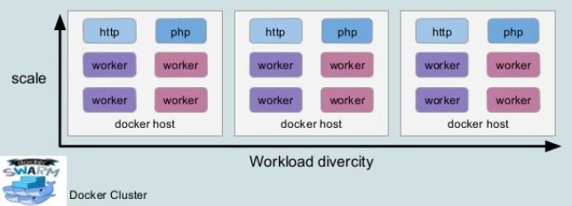
CONCURRENCY
SCALE OUT VIA THE PROCESS MODEL
8. CONCURRENCY
Using this model, the developer can architect their app to handle diverse workloads by assigning each type of work to a process type.
The share-nothing, horizontally partitionable nature of twelve-factor app processes means that adding more concurrency is a simple and reliable operation. The array of process types and number of processes of each type is known as the process formation.
Notes:
To change the image behind the Mock up.
Select the layer - > Right Click -> Send to Back -> Delete the image -> Drag & Drop your Own Picture -> Send to Back (again)

Slide 14
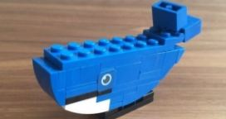
DISPOSABILITY
MAXIMISE ROBUSTNESS WITH FAST STARTUP AND GRACEFUL SHUT DOWN
9. DISPOSABILITY
The application should be disposable, which means it can be shut-down and restarted at a moment's notice. Therefore, the application must be designed to handle graceful shutdowns and ensure in-flight requests are handled correctly and no more HTTP requests are processed.
Container restart policies
Orchestration with docker swarm
Notes:
To change the image behind the Mock up.
Select the layer - > Right Click -> Send to Back -> Delete the image -> Drag & Drop your Own Picture -> Send to Back (again)

Slide 15
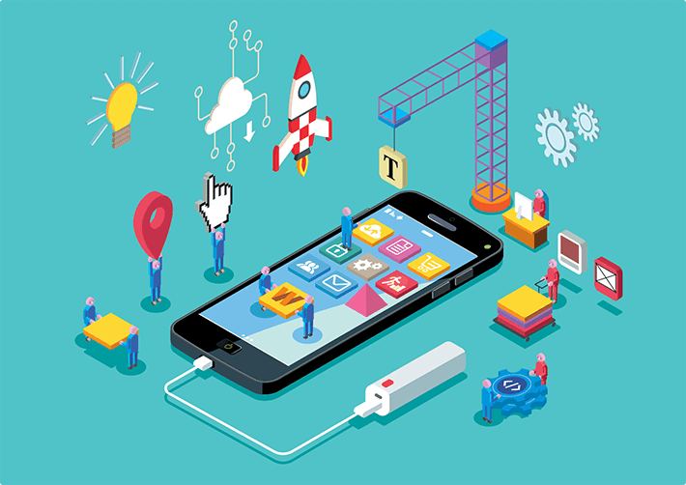
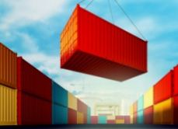
DEV PROD PARITY
KEEP DEVELOPMENT, STAGING AND PRODUCTION AS SIMILAR AS POSSIBLE
10. DEV PROD PARITY
Development, staging and production should be as similar as possible. Continuous deployment needs continuous integration based on matching environments to limit deviation and errors. If you keep dev, staging and production as similar as possible, anyone can understand it and release it. This is of course simply good development but it also enables a lot more scalability.
“Build once , run anywhere”
The same app images are used across DevOps stages
Notes:
To change the image behind the Mock up.
Select the layer - > Right Click -> Send to Back -> Delete the image -> Drag & Drop your Own Picture -> Send to Back (again)

Slide 16
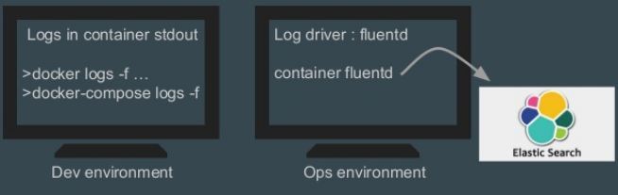
TREAT LOGS AS EVENT STREAMERS
LOGS
11. LOGS
Logging is important for debugging and checking up on the general health of your application. At the same time, your application shouldn’t concern itself with the storage of this information. Instead, these logs should be treated as a continuous stream that is captured and stored by a separate service. Each application process should write its event stream, unbuffered, to `stdout`. The execution environment should capture the stream and route the stream to the final destination. By using the Upstart service, the process stream is routed to the log file destination and it is responsible for the location of the stream.
Notes:
To change the image behind the Mock up.
Select the layer - > Right Click -> Send to Back -> Delete the image -> Drag & Drop your Own Picture -> Send to Back (again)

Slide 17


ADMIN PROCESSES
RUN ADMIN TASKS AS ONE-OFF PROCESS
12. ADMIN PROCESSES
This is more about managing the app rather than developing services, but it is still important. Admin tasks should be run from the relevant servers- possibly production servers. This is easiest done by shipping admin code with application code to provide these capabilities. The tools should be there even if they are not part of the standard execution of the service. What we try to do here is to isolate dependencies, as Admin processes and tools required to carry them out are dependencies as well.
docker exec….. is the command
Notes:
To change the image behind the Mock up.
Select the layer - > Right Click -> Send to Back -> Delete the image -> Drag & Drop your Own Picture -> Send to Back (again)

Slide 18
THANK YOU!!
THANK YOU!!

